Slide 1

Lead &
Opportunity
Scoring

Slide 2




Meet the team
Bing Lesley Yuan , Xin Li , Xinhui Lu , Ziyan Zhao , Raelene Huang
350274,1029029,965246, 1020405, 694488
Limited Resources!

Slide 3
The Client
& Project
Key Research
Question
Data
Methods
Interpretation & Analysis
The Client
Research Collaborations Constituents
Offers research collaboration, consultancy and innovation collaboration to industry partners
Too many opportunities to be handled by Business Development Managers
Scope of the Project
Pre-Processing
Model Validation
Model Monitoring
Data Integration
Model Training
Model Deployment
Machine learning Pipeline
Limited Resources!

Slide 4


Key Research Questions
Develop a scoring model to predict opportunity success
Gain insights and determine the key drivers of successful opportunities
Things we cannot control:
Integrity of the data
Lots of missing data entries
Key challenges:
Dealing with many missing data (data cleaning)
Feature selection & transformation
Imbalanced datasets
Other small data problems
Model interpretation and insight analysis
Machine learning Pipeline
Pre-Processing
Model Validation
Model Monitoring
Data Integration
Model Training
Model Deployment
The Client
& Project
Key Research
Question
Data
Methods
Interpretation & Analysis

Slide 5
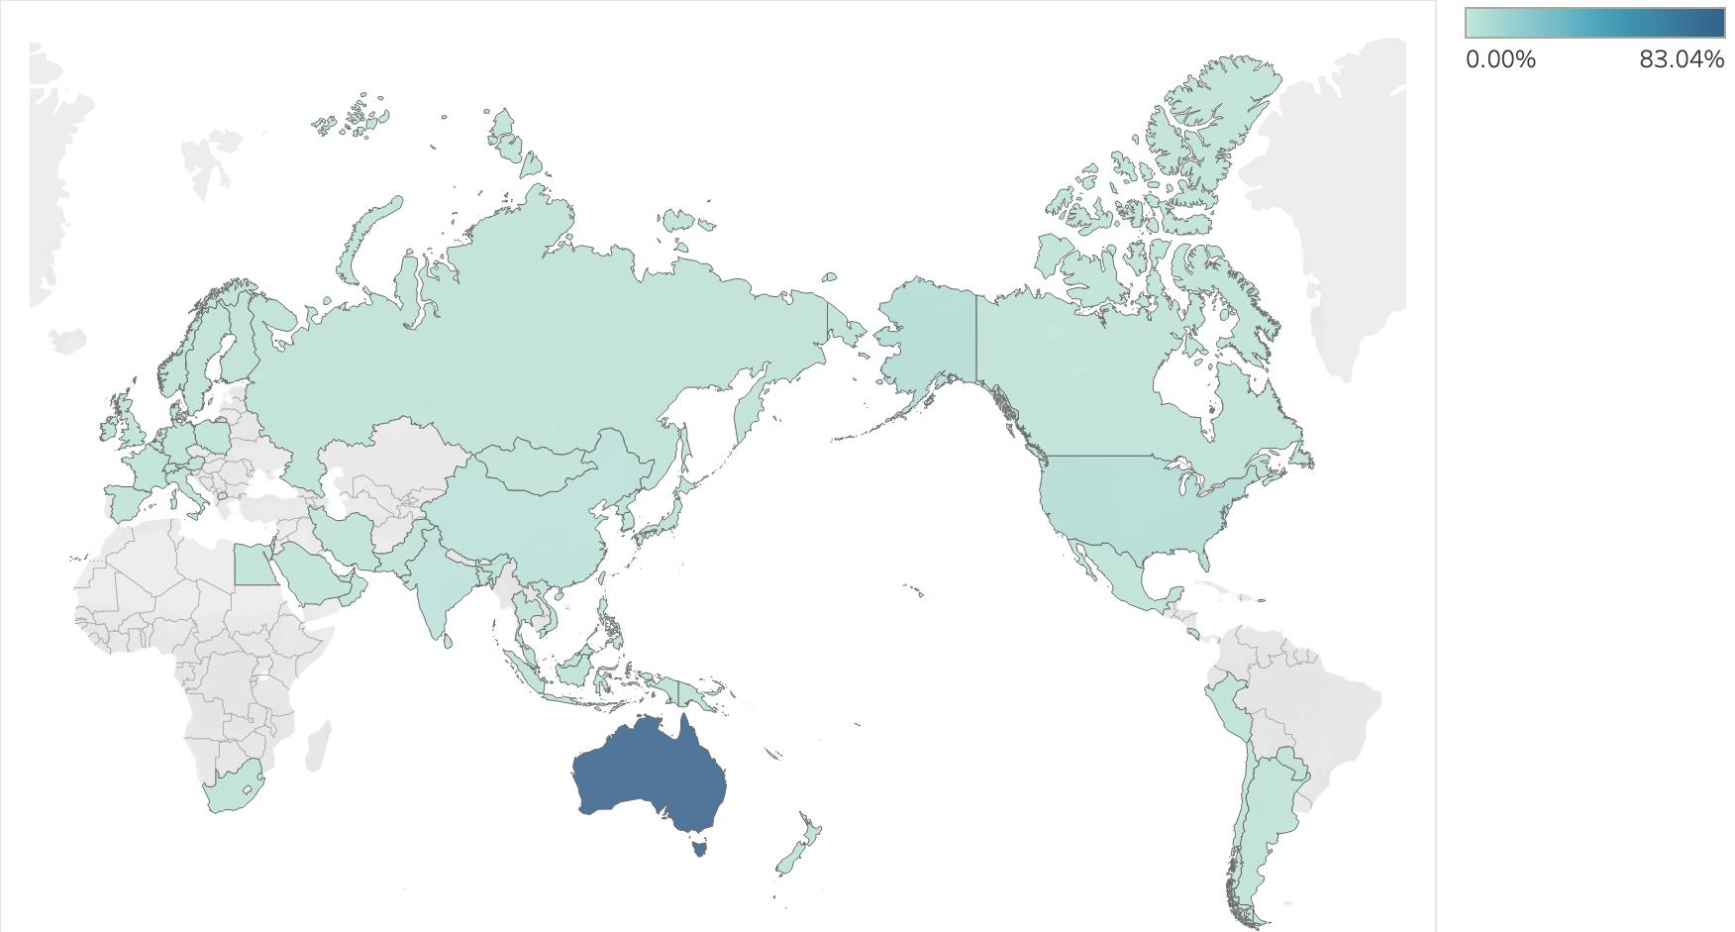
The Research Data
7598 opportunities
5408 opportunities
38 features
19 features
Successfully Converted Rate: 37%
External Opportunities: 99.2%
Australia, US, Europe and Asia

Slide 6
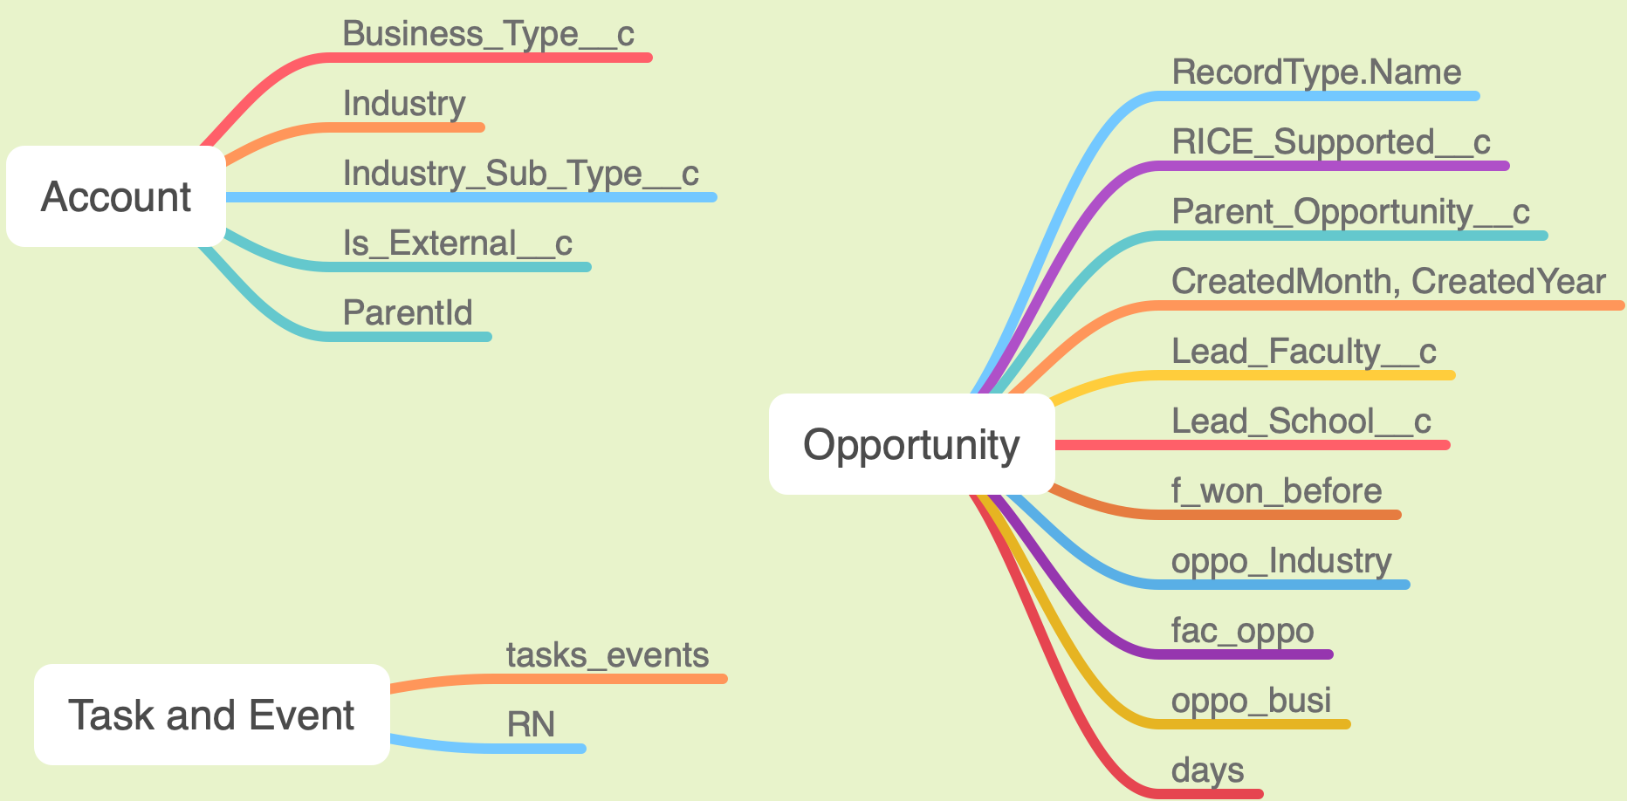


Slide 7
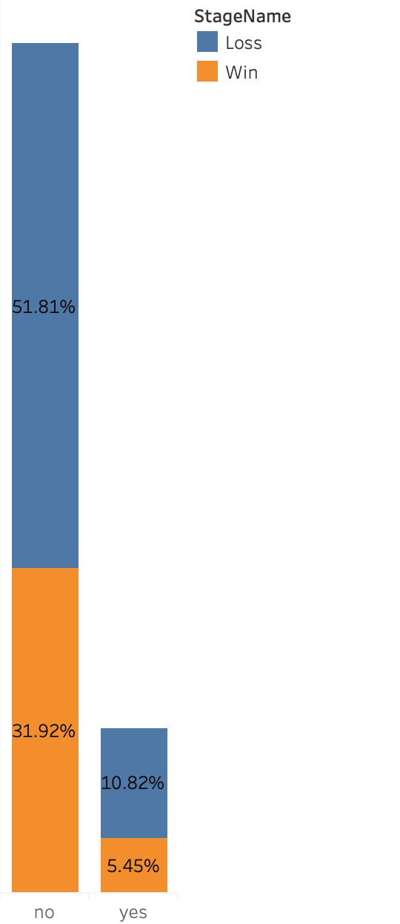
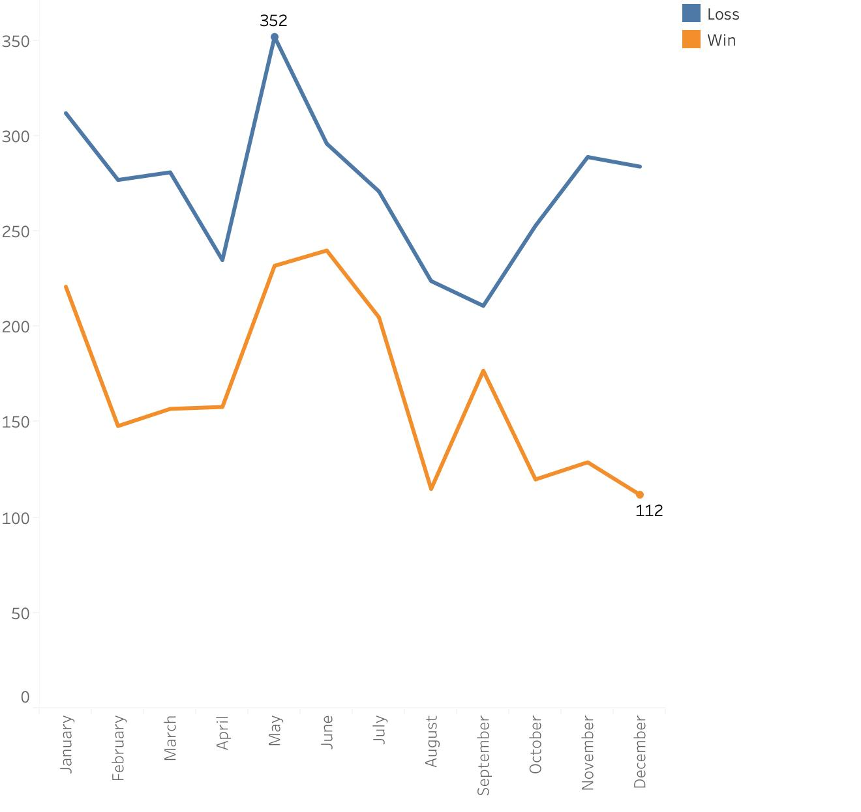
38% converted
33% converted
New Old
Clients

Slide 8
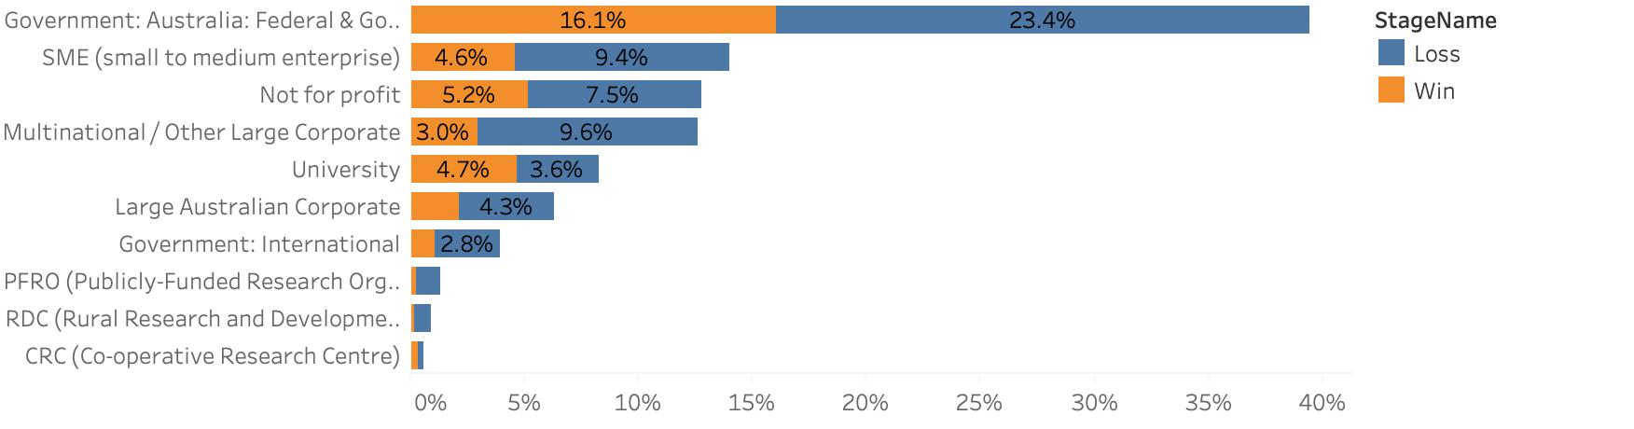

Business Types:
AVG:35%
41% converted
33% converted
57% converted
50% converted

Slide 9
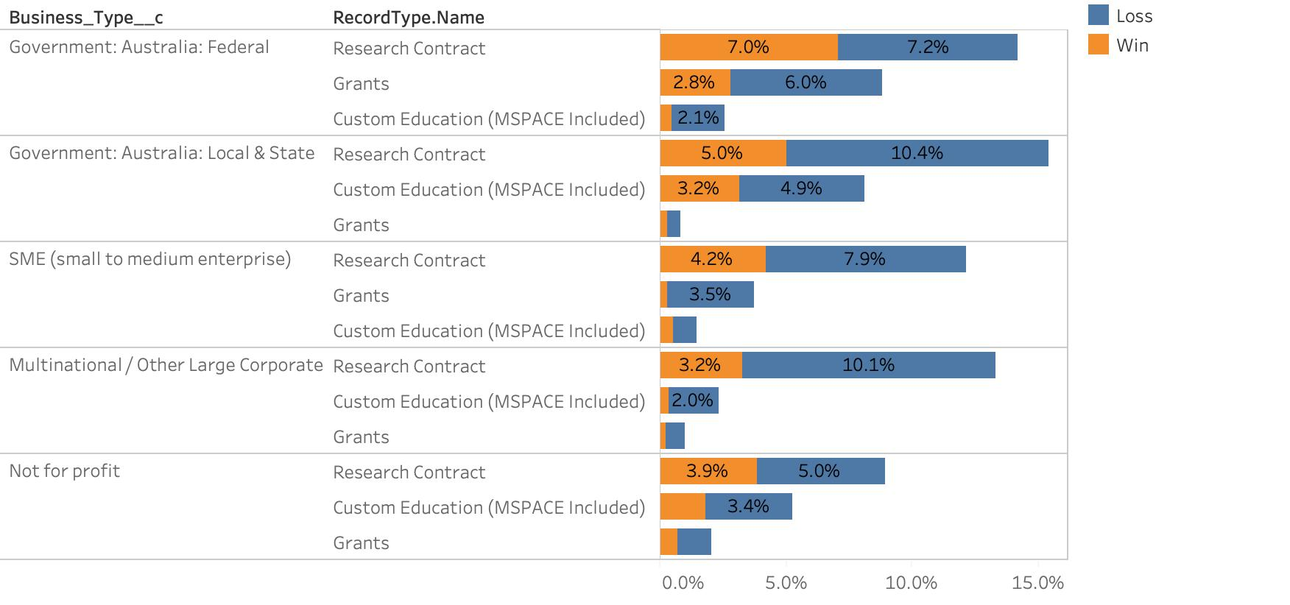

Slide 10
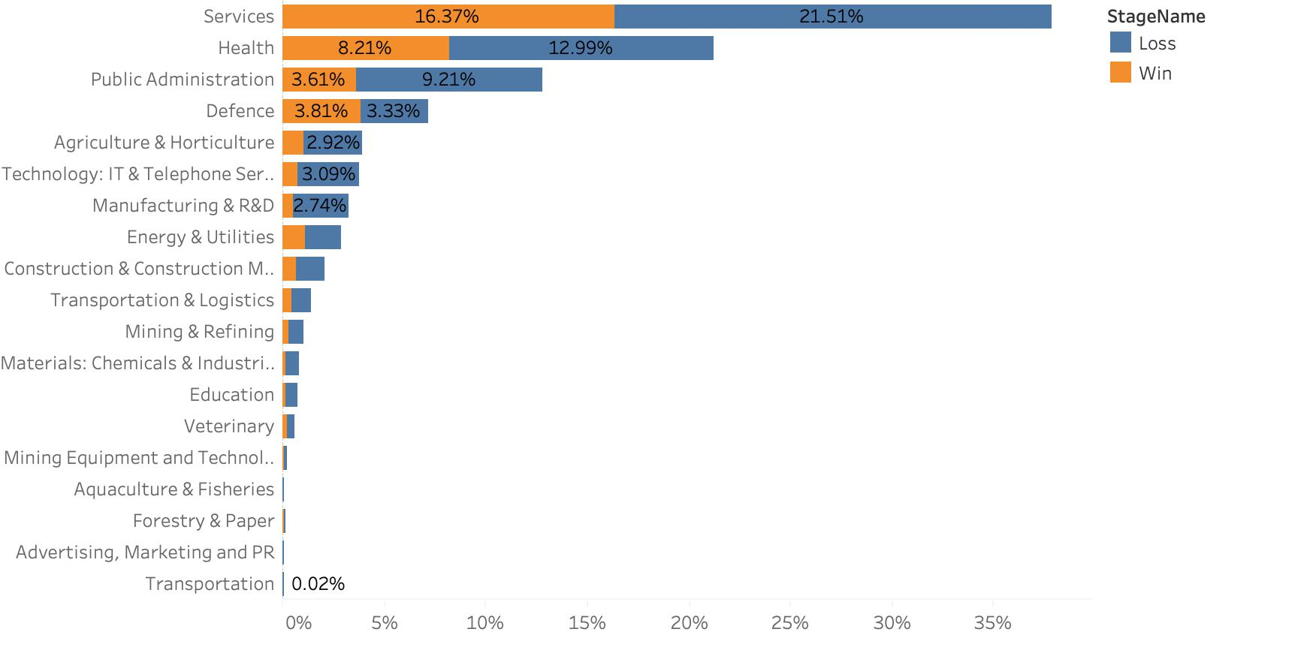
Industry:
AVG: 29%
43% converted
53% converted
18% converted

Slide 11
Added Features
Our own features:
RN
The total number of opportunities created with the same account.
F_won_before
If a previous opportunity has been won with this account before.
Days
Number of days between closed date and created date
Cross features:
Opportunity_industry
Faculty_opportunity
Opportunity_business
Dataset 1: Base
Dataset 2: Base + special-features
Dataset 3: Base + cross-features
Dataset 4: Base + special-features + cross-features

Slide 12
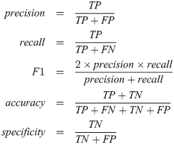
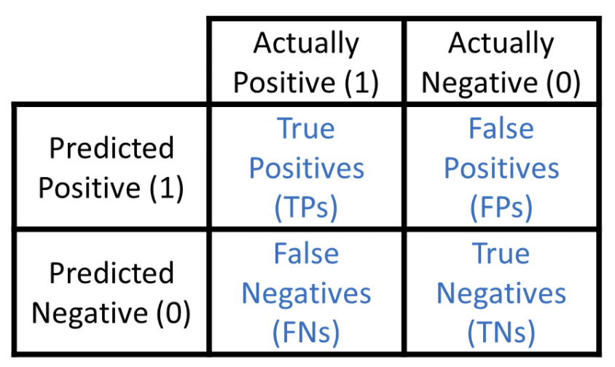
Classification Models
Logistic Regression
Support Vector Machines
Random Forest
Deep Neural Network
Evaluation Metrics
Population of Opportunities
Binary Classification Model
Successful
(Positive)
Unsuccessful
(Negative)

Slide 13
Balancing Data

Slide 14
Logistic Regression
01
Why LR first?
High interpretability
Can efficiently describe the relationship between a dependent binary class and the parameters
Examine the Significance of the Features
Give a baseline metric for our latter models
02
Evaluation method
Base (14 variables), additional (3 variables) and cross-features (3 variables)
Dataset 1: Base
Dataset 2: Base + special-feature
Dataset 3: Base + cross-features
Dataset 4: Base + special-feature + cross-features
03
Feature importance
19 variables and around 300 features
Only whose p-value < 0.05 are considered as significant features
Notes:
Script
Hi, I’m Ziyan. And I will start presenting the binary classification model section. We chose Logistic regression as our first model to give a baseline metric for our latter models, since LR has high interpretability, it can efficiently describe the relationship between a dependent binary class and the parameters and can examine the significance of the features.
Our models run on 4 different combinations of variables from the same dataset to seek the optimum.
Dataset 1 includes the 14 variables in the “Base” section, dataset 2 includes both the “Base” variables and 3 Special-feature variables, dataset 3 contains both the “Base” variables and 3 cross-feature variables, and dataset 4 contains all the variables.
We use R for LR modelling. As we can see from the graph, the result we have cannot prove our assumption that “the amount of feature has a positive impact on the performance of model “. dataset 2 has the highest score in all categories, however, the performance of other dataset is not optimal. Even though dataset 4 has the most features, it only performs slightly better than dataset 1 which has the least feature. On the other hand, dataset 2 and dataset 3 have the same amount of features, but the difference between the results is significant. base on the results, We have noticed that datasets with cross-features tend to have worse performance.
There are 19 variables and around 300 features. The number of features is more than the number of variables because the categorical variables are represented by multiple features as we are using one hot encoding.
We don’t include every feature into the final logistic model. We choose features by their p-value, only whose p-value less than 0.05 are considered as significant.
Next, Xinhui will talk about the model selection.
------------------------

Slide 15


Model selection
Research Data Set
5048 rows
15 features
Small data set
High bias & Low variance
SVM
Naive Byes
Limited Resources!

Slide 16

SVM & Oversampling
 | Imbalanced data set | Balanced data set
Accuracy | 0.6207 | 0.5975
Limited Resources!

Slide 17
Different Data Sets

Slide 18

Random Forest
No assumption for data
Without a large amount of tuning work
Features importance
Analysis

Slide 19
Random Forest
&
Oversampling
 | Imbalanced data set | Balanced data set
Accuracy | 0.61415 | 0.849015

Slide 20
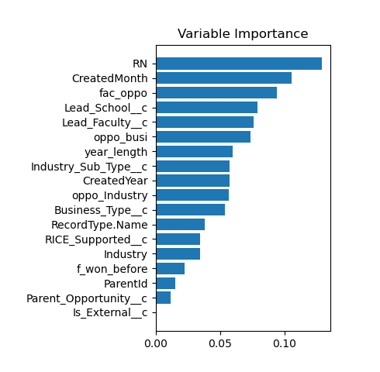

Different Data Sets
X EDUCATION

Slide 21
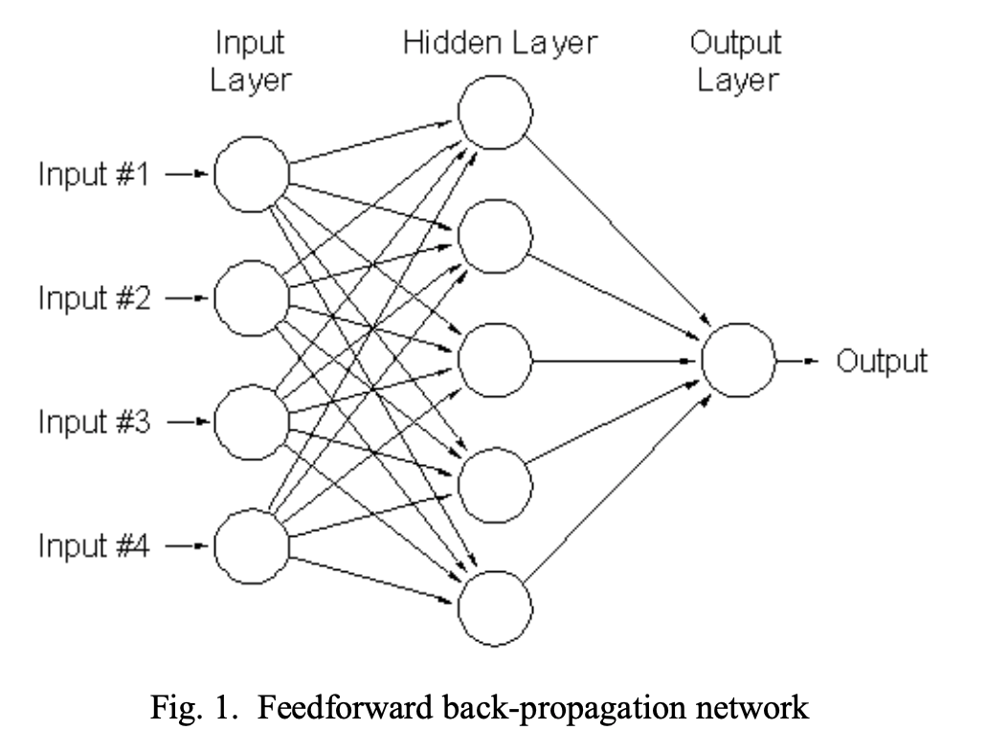
Deep Neural Network
01
Why?
Examine non-linearity in the features.
02
Hyperparameter Tuning
5 hidden layers
256 nodes per layer
ReLu activation function between the hidden layers
Sigmoid output function
03
Evaluation method
Base (14 variables), special-features (3 variables) and cross-features (3 variables)
Dataset 1: Base
Dataset 2: Base + special-features
Dataset 3: Base + cross-features
Dataset 4: Base + special-features + cross-features
Notes:
Script
Hi, I’m Ziyan. And I will start presenting the binary classification model section. We chose Logistic regression as our first model to give a baseline metric for our latter models, since LR has high interpretability, it can efficiently describe the relationship between a dependent binary class and the parameters and can examine the significance of the features.
Our models run on 4 different combinations of variables from the same dataset to seek the optimum.
Dataset 1 includes the 14 variables in the “Base” section, dataset 2 includes both the “Base” variables and 3 “Additional” variables, dataset 3 contains both the “Base” variables and 3 cross-feature variables, and dataset 4 contains all the variables.
We use R for LR modelling. As we can see from the graph, the result we have cannot prove our assumption that “the amount of feature has a positive impact on the performance of model “. dataset 2 has the highest score in all categories, however, the performance of other dataset is not optimal. Even though dataset 4 has the most features, it only performs slightly better than dataset 1 which has the least feature. On the other hand, dataset 2 and dataset 3 have the same amount of features, but the difference between the results is significant. base on the results, We have noticed that datasets with cross-features tend to have worse performance.
There are 19 variables and around 300 features. The number of features is more than the number of variables because the categorical variables are represented by features as we are using one hot encoding.
We don’t include every feature into the final logistic model. We choose features by their p-value, only whose p-value less than 0.05 are considered as significant. More specific, the the p-value, the more important the feature.
Next, …
------------------------

Slide 22
Comparing all models
Column1 | Logistic | SVM | Random Forest | DNN
Accuracy | 0.7345 | 0.6207 | 0.84902 | 0.84399
Precision | 0.6364 | 0.48561 | 0.81627 | 0.79324
Recall | 0.6467 | 1 | 0.88449 | 0.96808
F1_score | 0.6415 | 0.65375 | 0.84902 | 0.87143
Handover to Bing

Slide 23
How to interpret models
LIME
Local interpretable model-agnostic explanations
LIME also makes more human friendly explanations that explanations are selective and possibly contrastive
LIME does work better with models that output probabilities for classification problems
Why?
The better performing models are often called blackbox models such as random forests, XGboost trees or neutral networks and these models are generally more complex and don’t have a simple way for interpreting their predictions or outcome.
SHAP
Given the current set of feature values, the contribution of a feature value to the difference between the actual prediction and the mean prediction is the estimated Shapley value.
It is also possible to misinterpret shapley value.

Slide 24
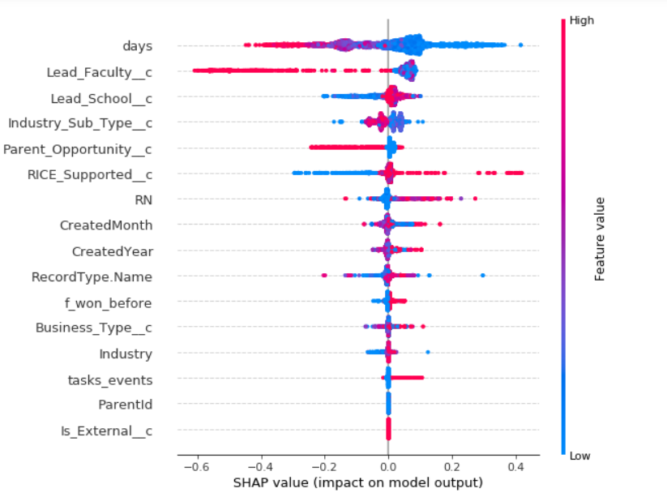
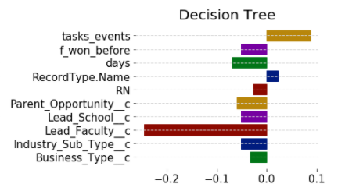
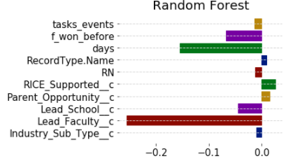
Results

Slide 25
THANK YOU!

Slide 26
Thank you
Any feedback?
Is handover required?
Audience didn’t understand what terms mean
Simple sentence at top: narrative on slide

